Slide 1
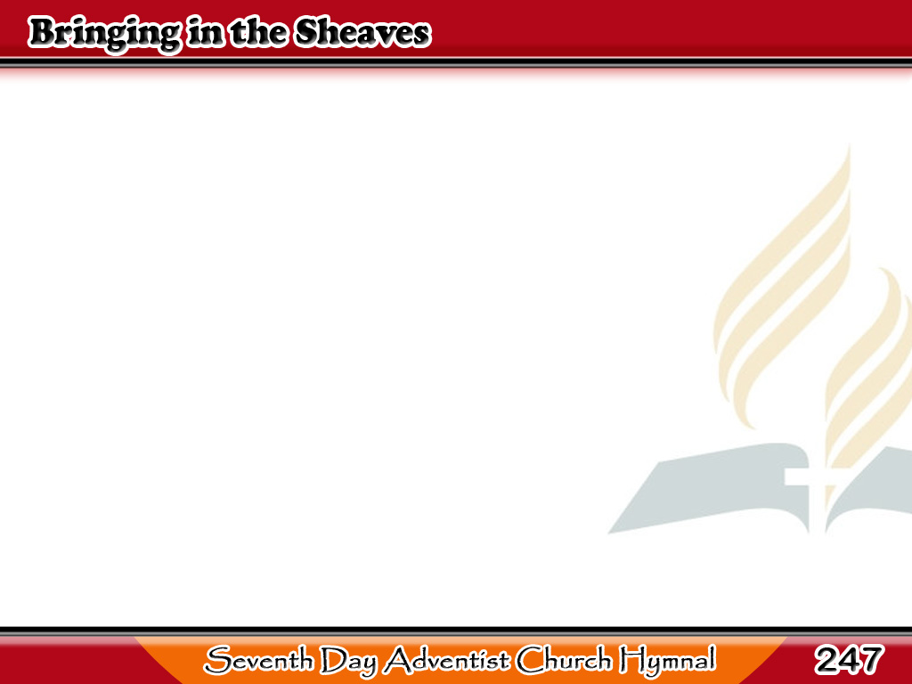
Ihasik ang Binhi
Sowing in the morning,
sowing seeds of kindness,
Sowing in the noontide
and the dewy eve;
1/3

Slide 2
Ihasik ang Binhi
Waiting for the harvest,
and the time of reaping,
We shall come rejoicing,
bringing in the sheaves.
1/3

Slide 3
Ihasik ang Binhi
-Refrain-
Bringing in the sheaves,
Bringing in the sheaves,
We shall come rejoicing,
Bringing in the sheaves;
1/3

Slide 4
Ihasik ang Binhi
-Refrain-
Bringing in the sheaves,
Bringing in the sheaves,
We shall come rejoicing,
Bringing in the sheaves.
1/3

Slide 5
Ihasik ang Binhi
Sowing in the sunshine,
sowing in the shadows,
Fearing neither clouds nor
winter’s chilling breeze;
2/3

Slide 6
Ihasik ang Binhi
By and by the harvest,
and the labor ended,
We shall come rejoicing,
bringing in the sheaves,
2/3

Slide 7
Ihasik ang Binhi
-Refrain-
Bringing in the sheaves,
Bringing in the sheaves,
We shall come rejoicing,
Bringing in the sheaves;
2/3

Slide 8
Ihasik ang Binhi
-Refrain-
Bringing in the sheaves,
Bringing in the sheaves,
We shall come rejoicing,
Bringing in the sheaves.
2/3

Slide 9
Ihasik ang Binhi
Going forth with weeping,
sowing for the Master,
Though the loss sustained
our spirit often grieves;
3/3

Slide 10
Ihasik ang Binhi
When our weeping’s over,
He will bid us welcome,
We shall come rejoicing,
bringing in the sheaves,
3/3

Slide 11
Ihasik ang Binhi
-Refrain-
Bringing in the sheaves,
Bringing in the sheaves,
We shall come rejoicing,
Bringing in the sheaves;
3/3

Slide 12
Ihasik ang Binhi
-Refrain-
Bringing in the sheaves,
Bringing in the sheaves,
We shall come rejoicing,
Bringing in the sheaves.
3/3

